Slide 1

Web Analytics

Slide 2
Outcome Analysis
Conversion Rate
It is the percentage of users who perform action that is desired by the website owner.
Eg. Conversion rate would be the percentage of website visitors who do any online transactions on the website.
The conversion rate can also be:
  Allowing the website to store the user’s ATM card information for easier checkout in the future.
  Signing up for a subscription that can be free or paid.
  Downloading the trial version software, a whitepaper, that allow people to progress in the sales funnel.

Slide 3
Outcome Analysis
Average order value
It can be formulated as the sum of revenue generated divided by a number of orders.
One can segment visitors and marketing campaigns into high, medium and low AOV groups and identify where the best (high AOV) customers are coming from.
Used to design campaign to increase AOV.
Revenue | E-commerce conversion rate | Transactions | AOV
3,605,924.97 | 4.90% | 3,599 | 1,001.92

Slide 4
Experience Analysis
Research Data
One can carry out research using three methods-
  Site survey
  Usability testing
  Site visits

Slide 5
Experience Analysis
Website Experimentation and Testing
Regularly experiment and test different things on the website to know what can be improved.
  A/B Testing
  Multivariate Testing (MVT)

Slide 6
Experience Analysis
A/B Testing
Here is a sample of the Google Analytics code that should be added to each test page:
    body onload="_gaq.push(['_setCustomVar', 1, 'abtest', 'variation2', 1]);"

Slide 7
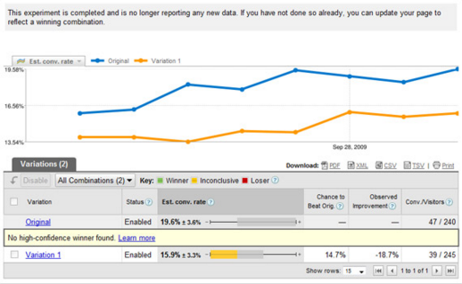
Experience Analysis
A/B Testing

Slide 8
Experience Analysis
MVT Testing
It is a technique that allows the test of multiple variants concurrently. To test three elements i.e. the heading, call to action and form
Total no. of variation= [No. of variation in element A]*[No. of variation in element B]*[No. of variation in Element C]

Slide 9
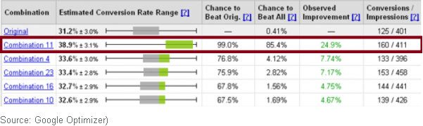
Experience Analysis
MVT Testing

Slide 10
Making Web Analytics Actionable
Context
Analytics will become actionable when it has context.
Important context is comparing metrics over a period
Second useful context is competition.
Sentence Construction

Slide 11
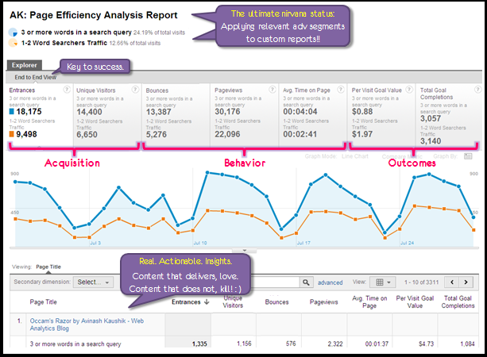
Making Web Analytics Actionable
Context

Slide 12
Making Web Analytics Actionable
High Impact Executive Dashboard
Filter the analytics that is most vital to organization
Quick and easy access to take decisions.
Limit their dashboard to maximum 10 metrics.

Slide 13
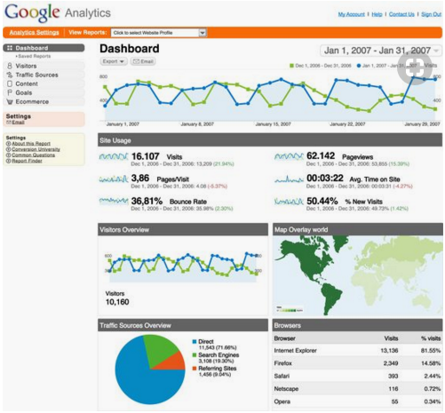
Making Web Analytics Actionable
High Impact Executive Dashboard

Slide 14
Making Web Analytics Actionable
Customer Segmentation
Segmentation can help in getting that data categorized
Helps one to slice and dice the data

Slide 15
Types of Tracking Codes
Google Analytics Code
This code is for tracking web analytics such as unique users, page views, bounce rate etc.
Google provides a free web analytics service that offers tracking and reporting of users for the websites.
When the code is put in the global element (header & footer), in which codes are applied to all pages.

Slide 16
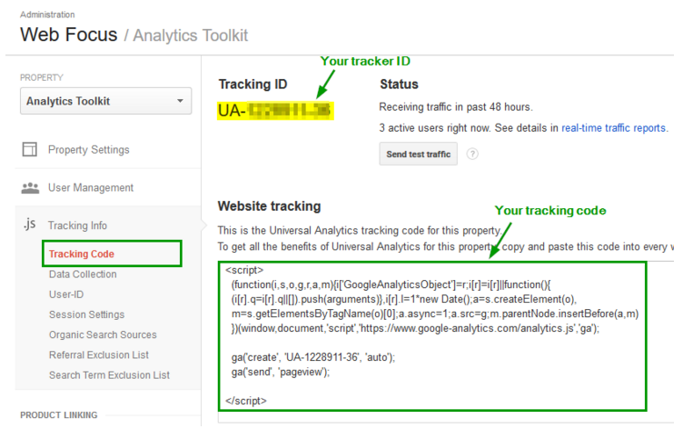
Types of Tracking Codes
Google Analytics Code

Slide 17
Types of Tracking Codes
Google Adwords conversion code
This code is used for tracking from campaigns run through Google Adwords.
One can take the code form ‘Tools’ sections in Google Adwords and put “Thank you” on the page.

Slide 18
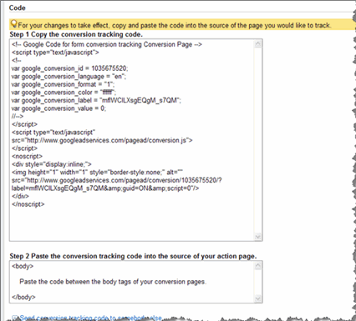
Types of Tracking Codes
Google Adwords conversion code

Slide 19
Types of Tracking Codes
Google Remarketing Code
If one wishes to remarket and show ads to users who visited their site, they must generate a remarketing code.
Different codes are generated by different platforms.

Slide 20
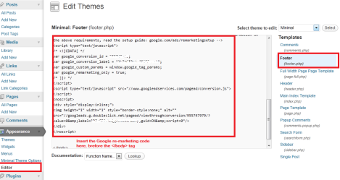
Types of Tracking Codes
Google Remarketing Code

